Slide 1
Churn/CLV Analysis
Mertcan Coskun

Slide 2
Goal of the project
Aim is to expand acquisition and increase retention
Knowing which profiles expected lifetime enables to adjust and calibrate investments
For that there are a few calculations which need to be done:
1. Compute portfolio LifeTime
2. Find Churn Drivers
3. Compute a LifeTime Model

Slide 3
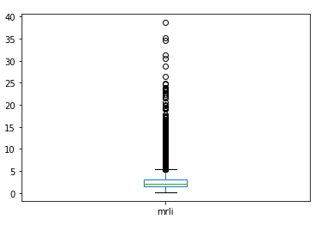
Descriptive statistics of value and churn
The V in CLV (mrli) is around 4 Euros with a lot of outliers.
Only 30% of customers we have now have churned.

Slide 4
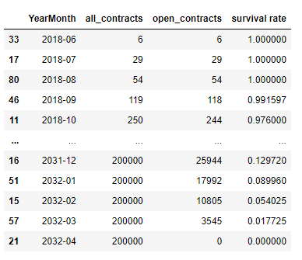
Computing portfolio LifeTime and value
Finding portfolios lifetime and value is very important for many departments, mainly finance.
In our case, the lifetime is 65 and total margin is 500K EURO and the portfolio lifetime value is about 33M EURO.
Survival rate is calculated as non churned contracts / all contracts

Slide 5
Churn Analysis
To do the churn analysis, the datasets are merged, cleaned and transformed.
Average churn rate is 30%, we will see if any subcategories differ significantly from that.
To analyze churn drivers, numerical columns will have correlation analysis and categorical values will be grouped by.

Slide 6
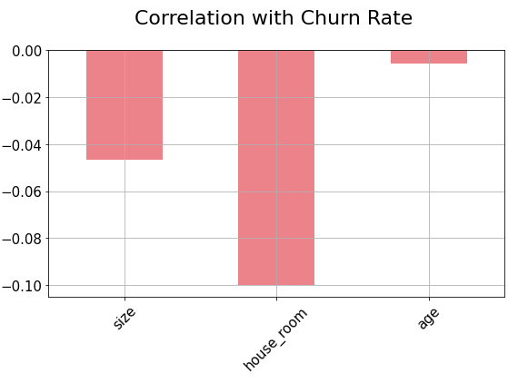
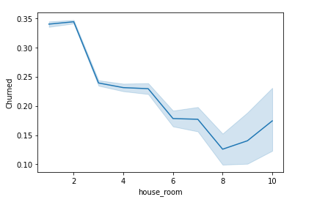
House room/size/age
Only house room seem to have a significant correlation with churn.
If we deep dive, we see that the higher the house room the less the churn.

Slide 7
Categorical values
Subcategories which have the highest churn rate and have a high user base are :
-BASIC&PLUS (formule)
-Germany(country)
-Home Content(product)
The category which have a big user base and low churn is Homeowner(occupant_type)
These categories are churn drivers, they receive the spotlight when their contract gets created.

Slide 8
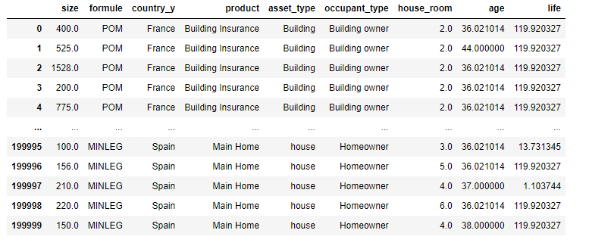
Computing a LifeTime Model
Data can be turned into a feature set and a simple regressor model can be implemented to assign a contract a lifetime at sale.
Life is the target column, which comes from churn and sale dates, the rest of the data are the features.
The predicted values can be compared to the life column

Slide 9
Conclusion
Now we know:
What the portfolio lifetime value is
Churn drivers which afffect the largest part of the business.
What lifetime to expect from new sales based on its features
This helps us better financial, marketing and product based decisions.

